Slide 1
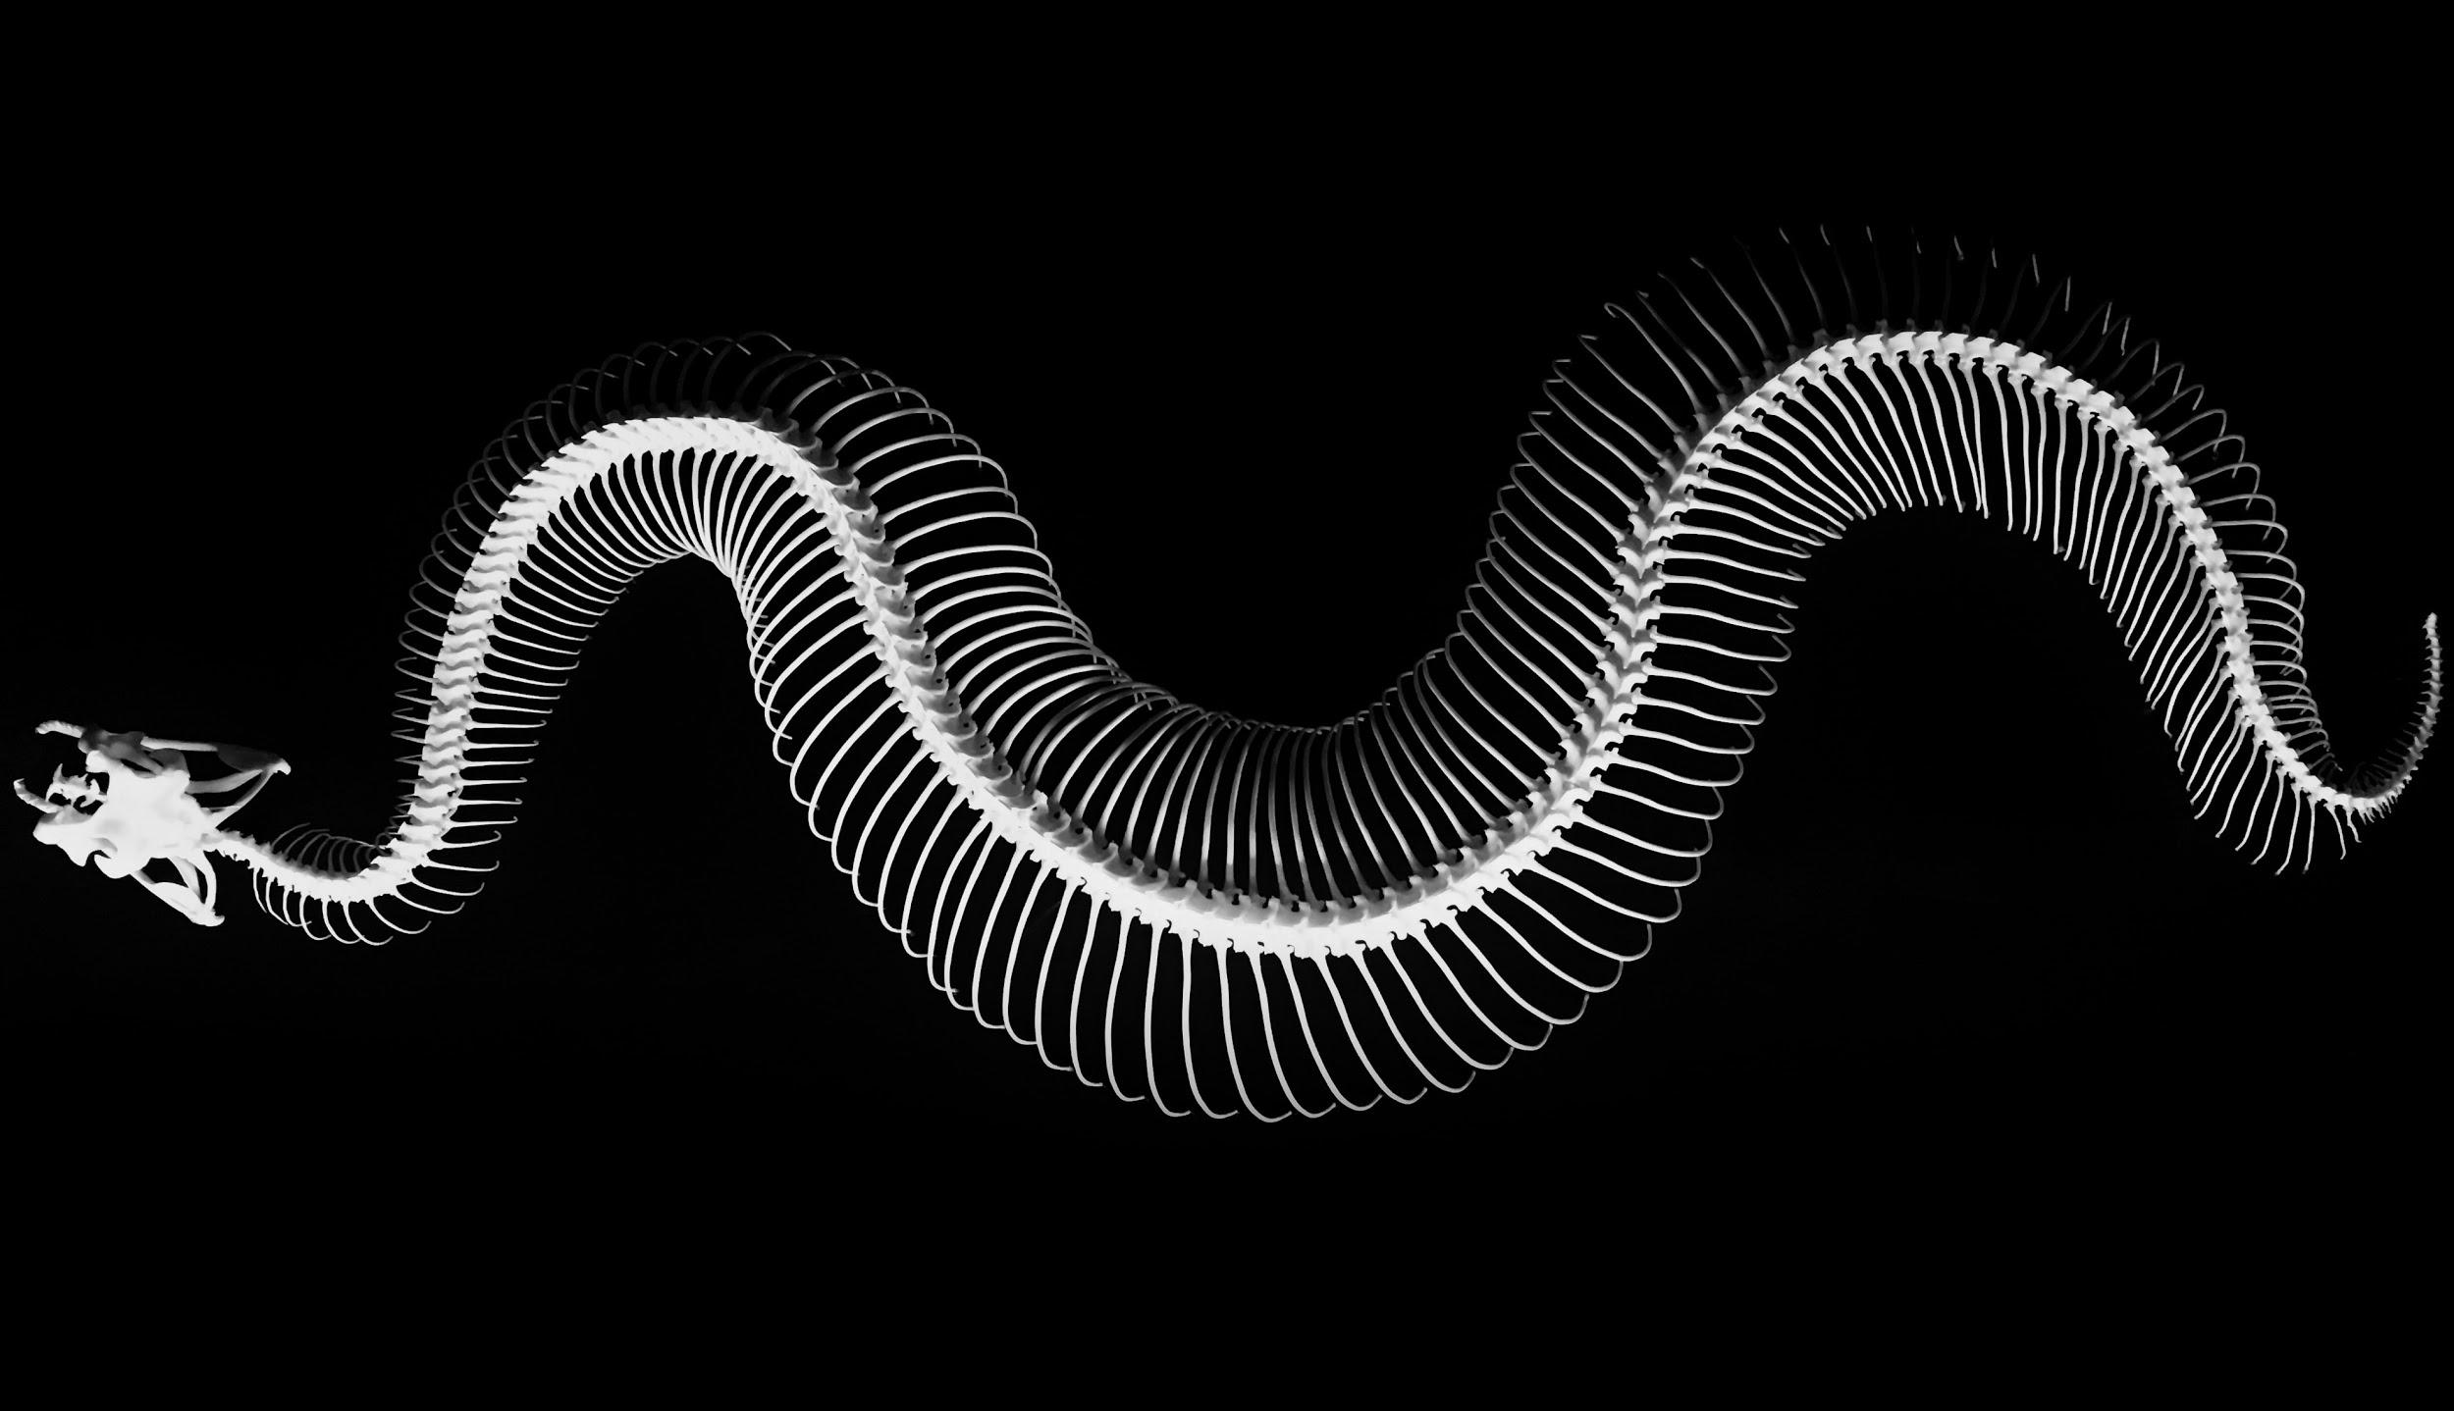
VERTEBRATES
We will identify observable features of vertebrates
Notes:
Insert cover image and use transparency settings to fade image.

Slide 2
Do not delete this slide.
This slide is designed so that you can copy the prompt box you need and insert it into your slides.
This slide is hidden and will not be included when presenting your lesson.
TRACK WITH ME
VOCABULARY
1 -
HINT
Students, remember….
CHECK FOR UNDERSTANDING
READ WITH ME
TEACHER CUE
MAKE THE CONNECTION
Students, you already know….
EXTENSION
GESTURE WITH ME

Slide 3
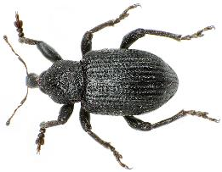
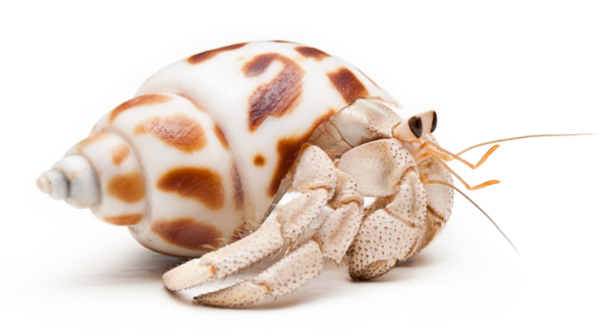
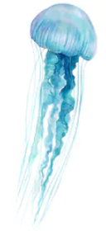
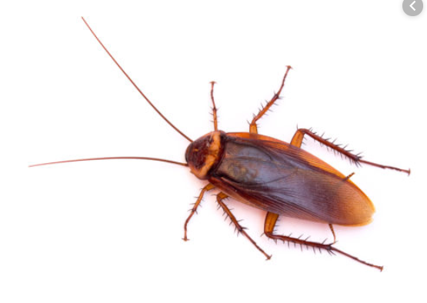
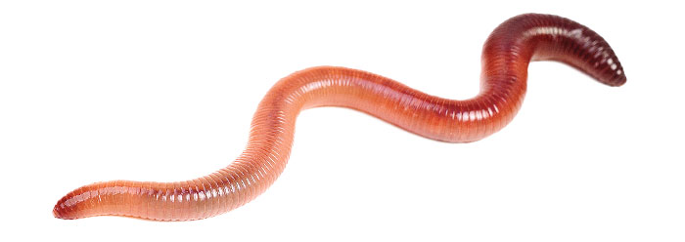
Match the observable features to the invertebrates below.
A: Hermit crab
D: Beatle
Observable features
Exoskeleton
Shell
Antennae
Soft body
Tentacles
B: Cockroach
E: Jellyfish
C: Worm

Slide 4
Repeat the opposite word/phrase.
ORGANISM
LIVING THING

Slide 5
Repeat the opposite word/phrase.
CHARACTERISTICS
FEATURES OR QUALITIES

Slide 6
Repeat the opposite word/phrase.
OFFSPRING
CHILDREN OR YOUNG OF AN ORGANISM

Slide 7
Repeat the opposite word/phrase.
REPRODUCE
MAKE OFFSPRING

Slide 8
Repeat the opposite word/phrase.
CLASSIFICATION SYSTEM
GROUPS WITH SIMILAR CHARACTERISTICS

Slide 9
Fill in the missing definition of variable below
Type of Variable | Definition
Independent Variable
Dependent Variable
Control Variables

Slide 10
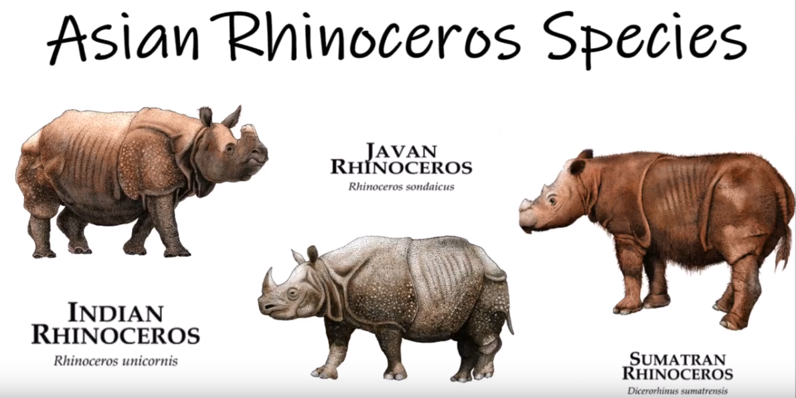
Why do scientists need a system to classify plants and animals?
English | rhinoceros
French | rhinocéros
Italian | rinoceronte

Slide 11
We will identify observable features of vertebrates.
TRACK WITH ME
READ WITH ME
We will define a vertebrate.
We will list observable features of different vertebrates.
We will give observable features to classify vertebrates.
DECLARE THE OBJECTIVE
Read the learning objective to your partner.
Notes:
Learning Objectives contain concepts (nouns, big ideas), skills (verbs, measurable behaviours) and sometimes context (restricting or targeting conditions).
●Example: Students will be able to describe the concept of density and apply it to floating and sinking.
●
Success criteria are specific measurable outcomes that if met mean that the student has met the learning objective.
Examples:
•Students will be able to compare densities of substances using mass and volume.
•Students will be able to identify whether a solid or liquid will float or sink in a liquid based on their densities.

Slide 12
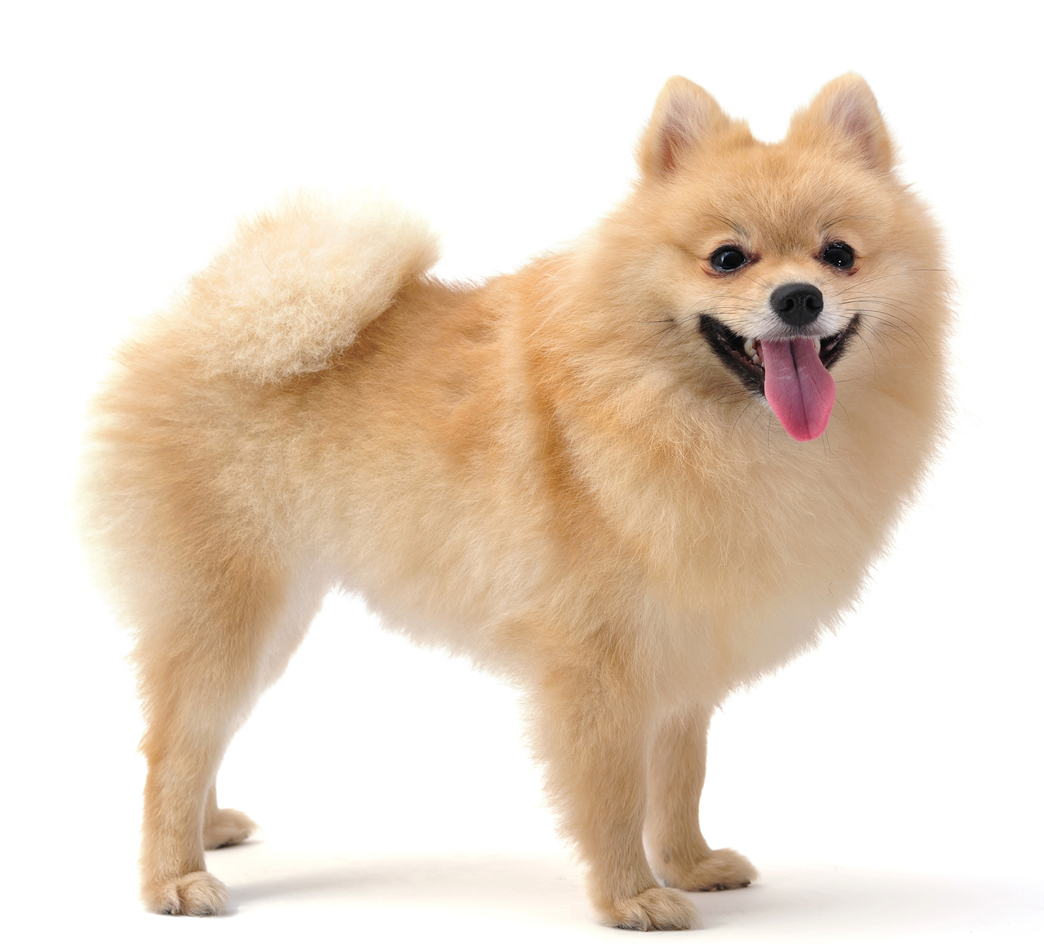
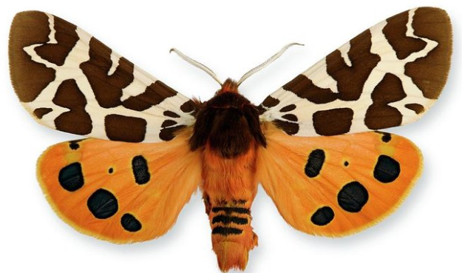
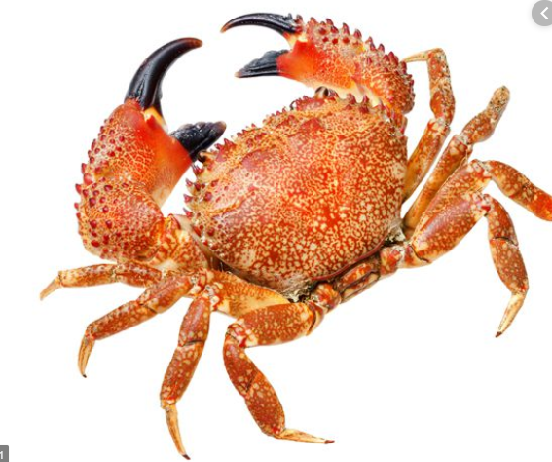
We will identify observable features of vertebrates.
Classification is a system of sorting organisms such as plants and animals into different groups based on observable features.
What is one observable difference between the moth, crab and dog?
MAKE THE CONNECTION
Students, you already know…. Observable features are what a plant or animal looks like. They are used to group animals into similar groups.

Slide 13
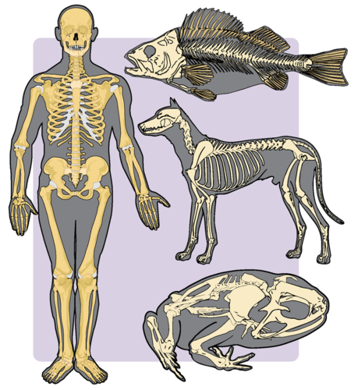
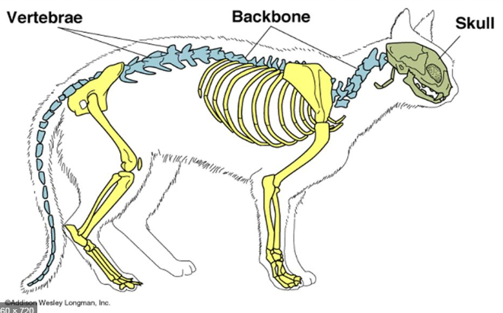
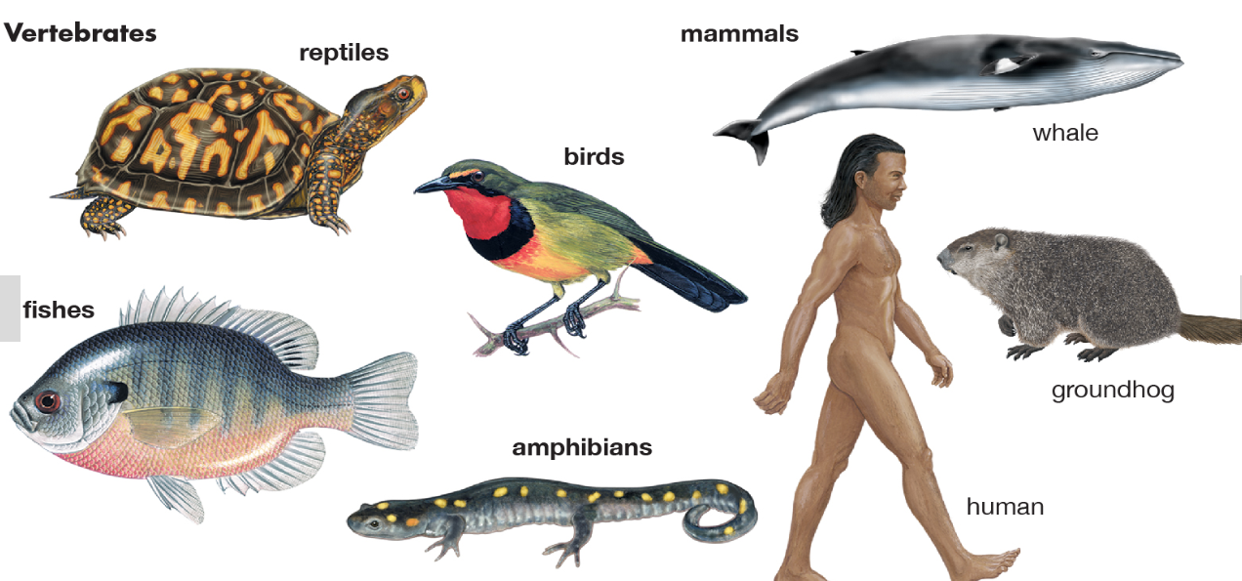
We will identify observable features of vertebrates.
CHECK FOR UNDERSTANDING
What features do all vertebrates have in common?
Vertebrates are animals that have a skeleton and a backbone on the inside of their body.
Skeletons are made up of hard bones and softer bone called cartilage. The vertebrae are bones in the spine.
3% of animals on the planet are vertebrates.
Notes:
Diagram from https://www.ck12.org/book/CK-12-Biology-Concepts/section/12.2/
https://www.britannica.com/animal/vertebrate

Slide 14
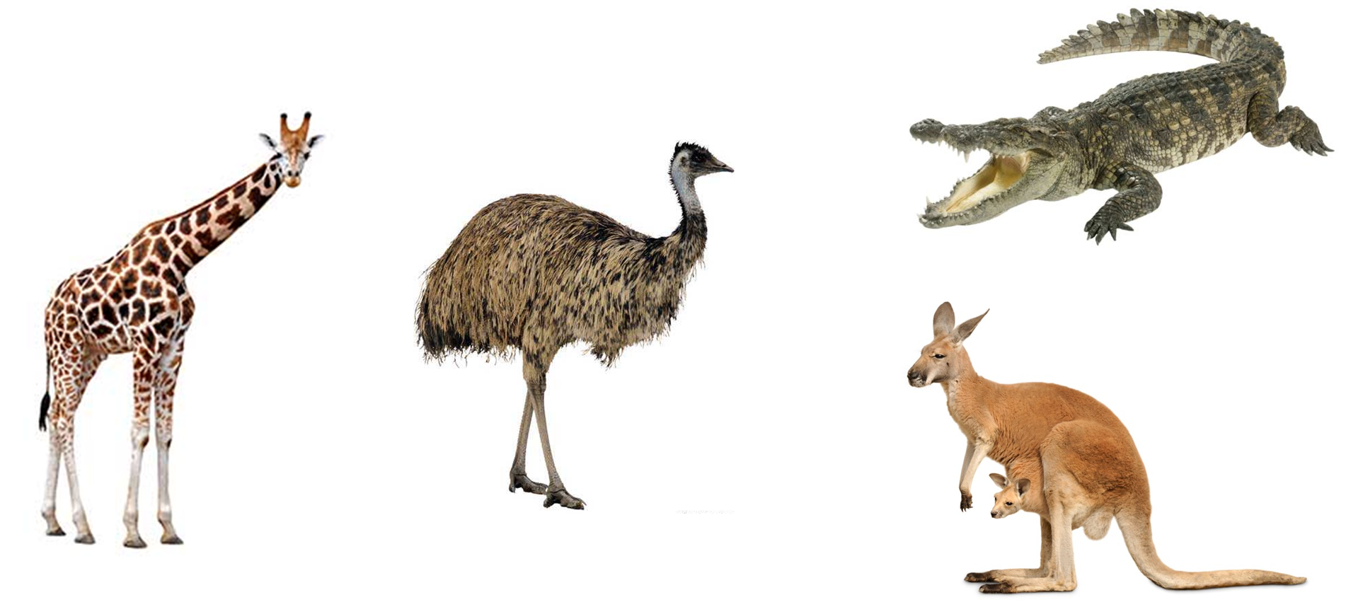
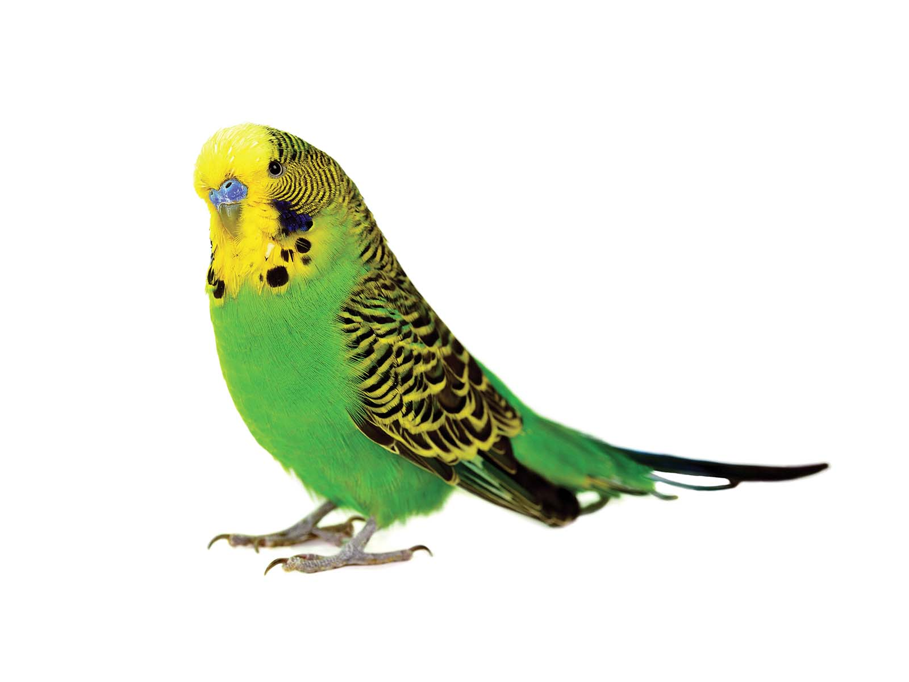
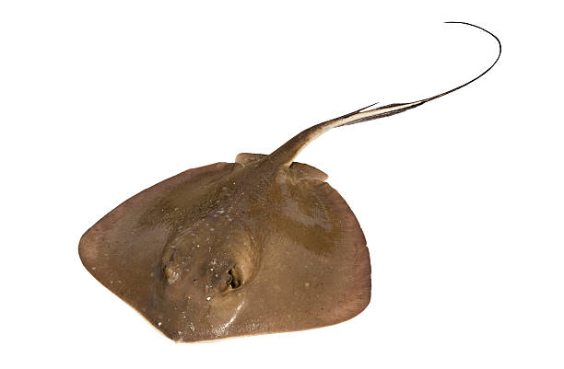
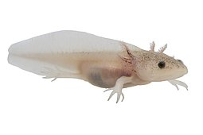
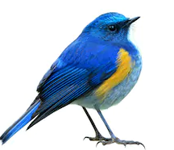
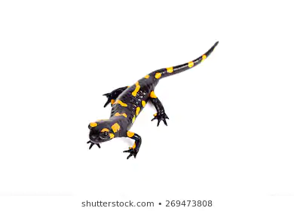
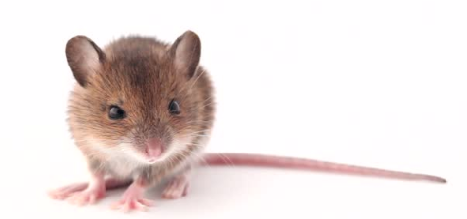
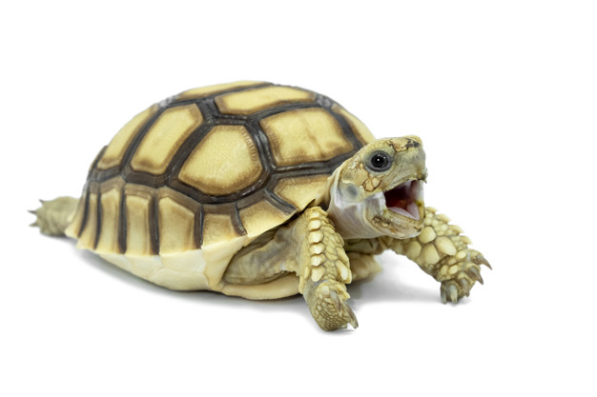
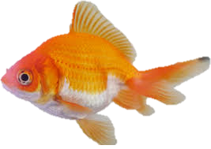
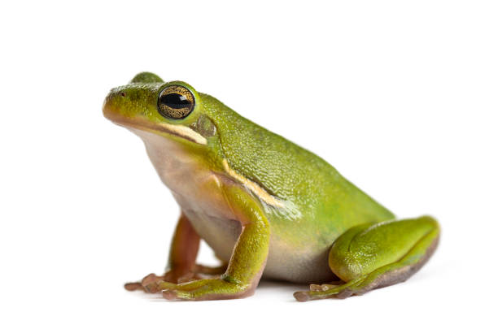
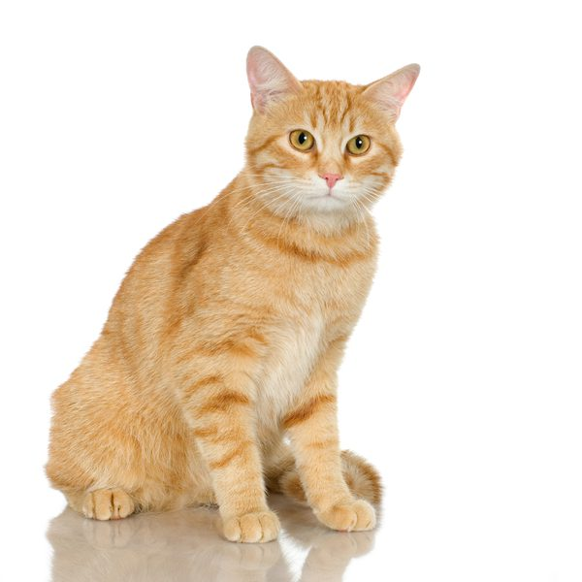
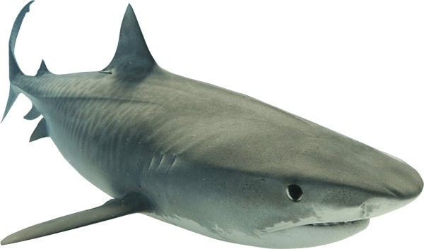
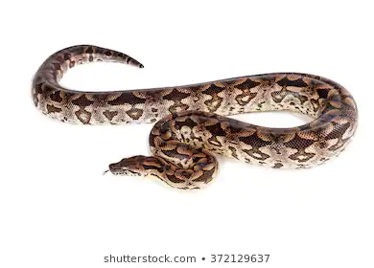
We will identify observable features of vertebrates.
Vertebrates have internal skeletons but their observable features on the outside look very diverse₁.
Vertebrates are classified into 5 different groups based on what covers their skeleton.
CHECK FOR UNDERSTANDING
Compare 2 of the animals below, what covers their skeleton?
Birds
Fish and Rays
Reptiles
Mammals
Amphibians
VOCABULARY
1 - different
Notes:
Please note some of these images are not copywrite free (we may need to purchase an account to get some high quality pictures for 2020)

Slide 15
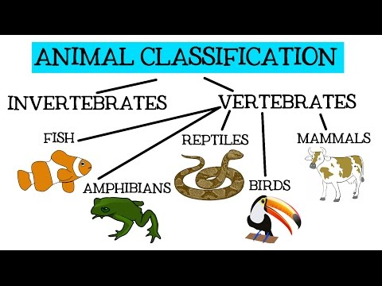
We will identify observable features of vertebrates.
CHECK FOR UNDERSTANDING
Why can’t we classify animals by where they live?
TEACHER CUE
Start the video at 2.08 to review vertebrates.

Slide 16
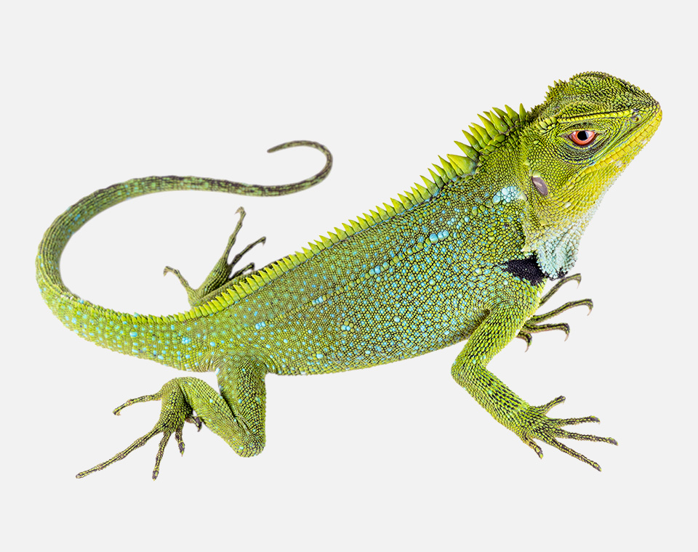
We will identify observable features of vertebrates.
CHECK FOR UNDERSTANDING
A scientist finds the animal below. It has rough, dry scales. What animal group could it be classified as?
Vertebrates are classified into five different groups based on what covers their skeleton.
Observable feature | Group | Animal examples
Wings Feathers Beak | Birds | Emus, parrots, magpies and galahs
Fur Hair Mammary glands | Mammals | Lions, dogs, bears, humans and whales
Dry scales Hard shell | Reptiles | Crocodiles, turtles and snakes
Wet skin Soft skin | Amphibians | Frogs, toads and salamanders
Wet scales Boney skin | Fish and Rays | Shark, goldfish, stingrays
EXTENSION
Marine mammals such as whales and dolphins have modified fur on parts of their bodies.

Slide 17
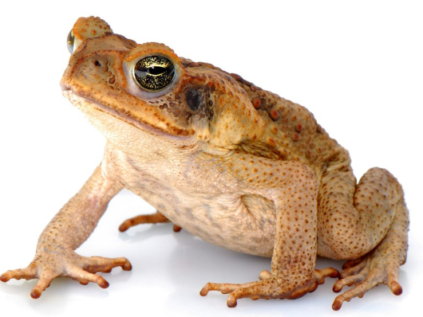
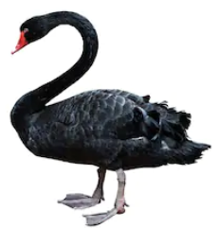
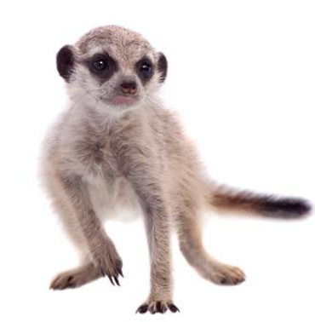
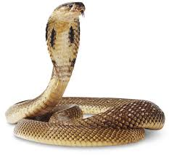
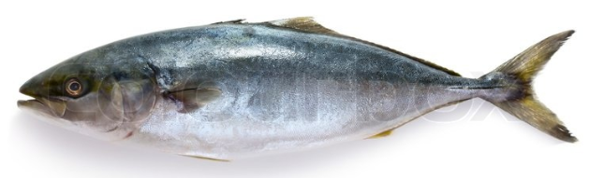
We will identify observable features of vertebrates.
CHECK FOR UNDERSTANDING
Fish and reptiles both have scales. How can you describe the difference between them?
Match the observable features to the vertebrates below.
Observable features
Dry Scales
Feathers
Wet Scales
Soft wet body
Fur
B: Cane Toad
HINT
Observable feature | Group
Wings Feathers Beak | Birds
Fur Hair Mammary glands | Mammals
Dry scales Hard shell | Reptiles
Wet skin Soft skin | Amphibians
Wet scales Boney skin | Fish and Rays
A: Black Swan
C: Meerkat
E: Cobra
D: Tuna

Slide 18
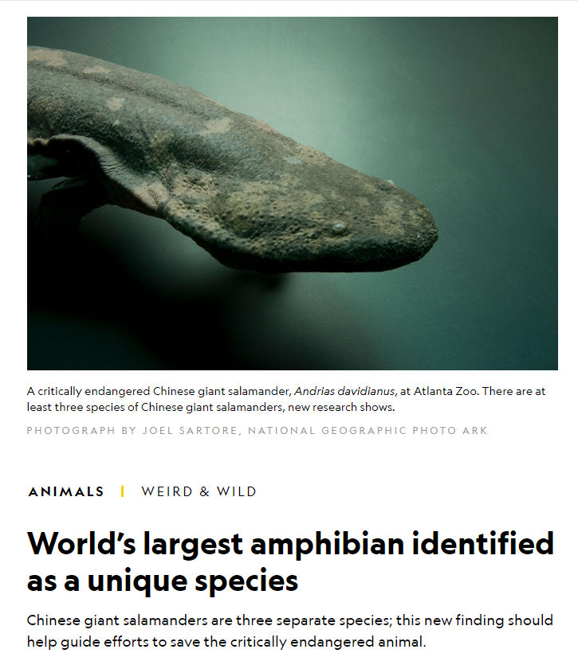
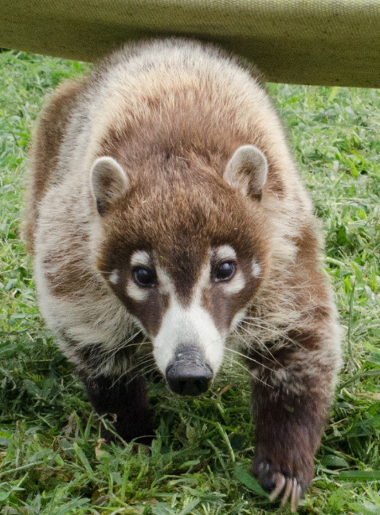
We will identify observable features of vertebrates.
CHECK FOR UNDERSTANDING
If you were a Scientist and you found this animal. What group might this animal belong to? Coatis
It is important to know the observable features of vertebrates.
This helps Scientists identify new animals in the environment that look like others that are already classified.
Notes:
Article: https://www.nationalgeographic.com/animals/2019/09/giant-salamander-new-species-worlds-largest-amphibian/
https://www.turpentinecreek.org/species/coatimundi/

Slide 19
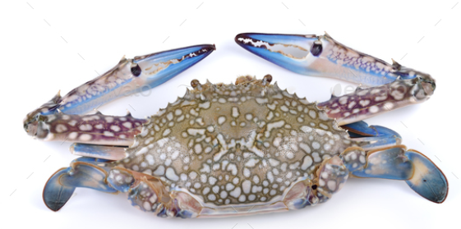
We will identify observable features of vertebrates.
Vertebrates are animals that have a skeleton and a backbone on the inside of their body. Vertebrates are classified into five different groups based on what covers their skeleton.
CHECK FOR UNDERSTANDING
Is the animal below a vertebrate? Explain your answer
Observable feature | Group | Animal examples
Wings Feathers Beak | Birds | Emus, parrots, magpies and galahs
Fur Hair Mammary glands | Mammals | Lions, dogs, bears, humans and whales
Dry scales Hard shell | Reptiles | Crocodiles, turtles and snakes
Wet skin Soft skin | Amphibians | Frogs, toads and salamanders
Wet scales Boney skin | Fish and Rays | Shark, goldfish, stingrays

Slide 20
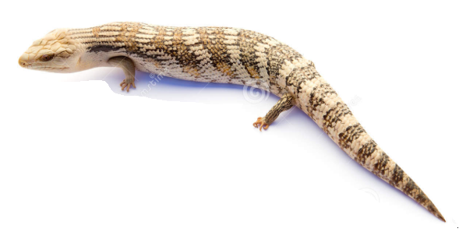
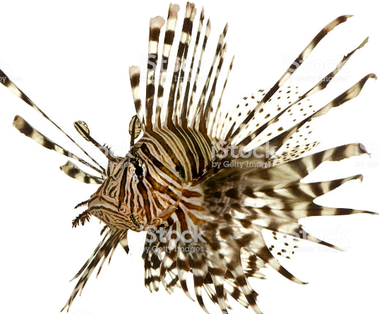
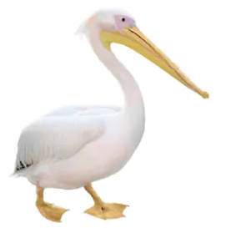
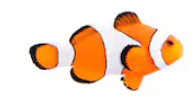
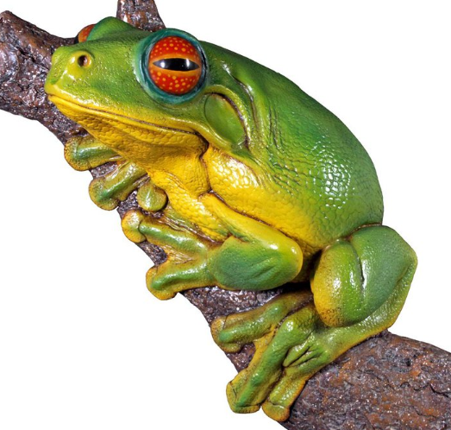
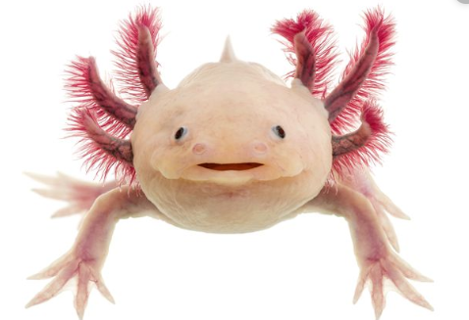
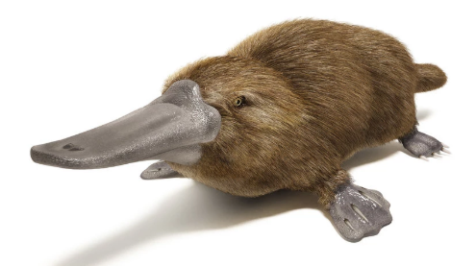
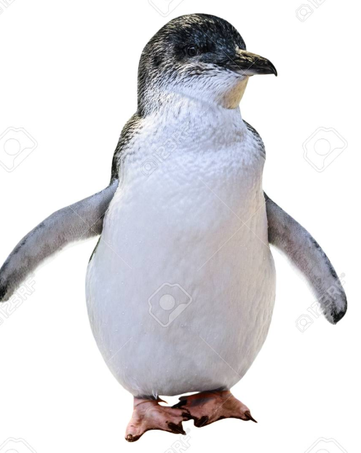
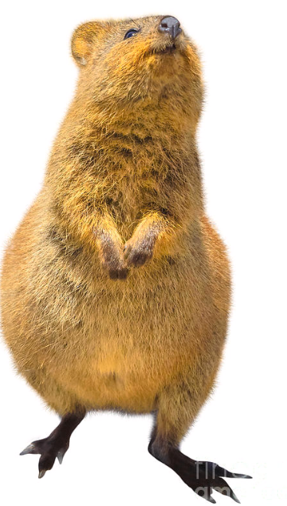
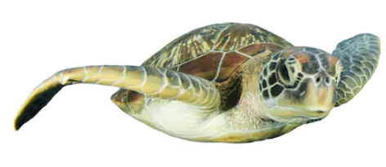
We will identify observable features of vertebrates.
10
Classify the following animals with the observable features below.
Observable feature | Group | Vertebrates with this feature
Wings Feathers Beak | Birds
Fur Hair Mammary glands | Mammals
Dry scales Hard shell | Reptiles
Wet skin Soft skin | Amphibians
Wet scales Boney skin | Fish and Rays
7
4
1
5
2
8
6
9
3
Notes:
Please include tasks/questions here rather than just referring to a worksheet. This will save on photocopying and facilitate sharing with other schools.
Try and build tasks/questions which escalate through Bloom’s Taxonomy. This will help with differentiation.

Slide 21
We will identify observable features of vertebrates
We will define an vertebrate.
We will list observable features of different vertebrates.
We will give observable features to classify vertebrates.
CHECK FOR UNDERSTANDING
Check Success Criteria.

